Slide 1
Input/Output
Chapter 5
5.1 Principles of I/O hardware
5.2 Principles of I/O software
5.3 I/O software layers
5.4 Disks
5.5 Clocks
5.6 Character-oriented terminals
5.7 Graphical user interfaces
5.8 Network terminals
5.9 Power management

Slide 2
Input/Output
One main function of an OS is to control all the computer’s I/O devices.
It must
  Issue commands to the devices.
  Catch interrupts.
  Handle errors.
It should provide an interface between the devices and the rest of the system that is simple and easy to use.
  To the extent possible, the interface should be same for all devices (device independence).

Slide 3
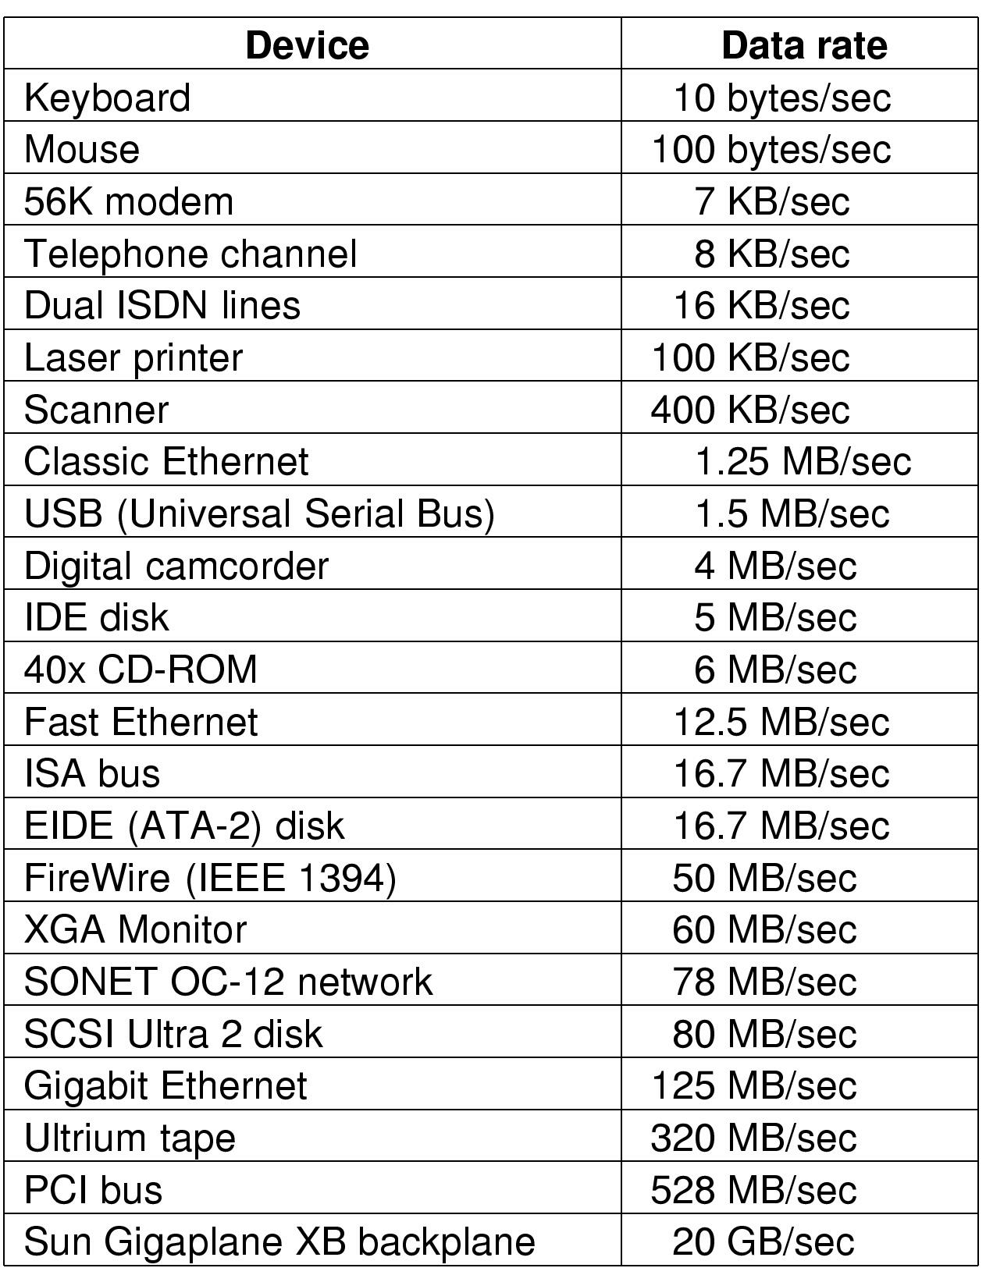
Principles of I/O Hardware
Some typical device, network, and data base rates

Slide 4
I/O devices
Can be roughly divided into two categories:
Block devices: stores information in fixed-size blocks, each one with its own address.
  (Common blocks range from 512 bytes to 32768 bytes)
  Essential property of block device is that it is possible to read or write each block independently of all the other ones.
  Disk are the common block devices.
Character devices: delivers or accepts a stream of characters without regard to any block structure.
  Printers, mouse (for pointing), network interfaces are character devices.

Slide 5
Device Controllers
I/O devices have components:
  mechanical component
  electronic component called device controller or adapter.
The electronic component is the device controller
  may be able to handle multiple devices
Controller's tasks
  convert serial bit stream to block of bytes
  perform error correction as necessary
  make available to main memory

Slide 6
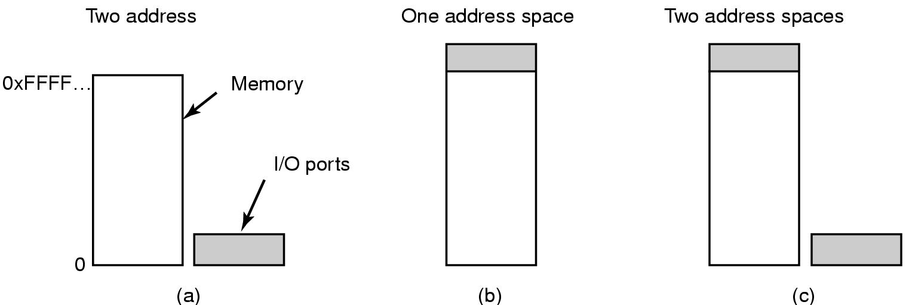
Memory-Mapped I/O (1)
Separate I/O and memory space
Memory-mapped I/O
Hybrid

Slide 7
Memory mapped I/O
Each controller has a few registers that are used for communicating with the CPU.
By writing to these registers, the OS can command device to deliver data, accept data, switch itself on or off, otherwise perform some action.
By reading from these registers, the OS can learn what the device’s state is, whether it is prepared to accept new command and so on.
In addition to the control registers, many devices have a data buffer that the OS can read and write.
  Example, a common way for computers to display pixels on the screen is to have a video RAM which is available for programs or the OS to write into.
The issue thus arises of how the CPU communicates with the control registers and the device data buffers.

Slide 8
Memory mapped I/O
Two alternatives exist.
One approach is each control register is assigned an I/O port number, an 8- or 16-bit integer.
Using a special I/O instruction such as IN REG, PORT
  The CPU can read in control register PORT and store the result in CPU register REG.
Similarly using OUT PORT, REG
  The CPU can write the contents of REG to a control register.
In this scheme, the address spaces for memory and I/O are different.
The second approach is to map all the control registers into the memory space.
Each control register is assigned a unique memory address to which no memory is assigned. This system is called memory-mapped I/O.

Slide 9
Memory mapped I/O
How this scheme works?
In all cases, when CPU wants to read a word either from memory or from an I/O port, it puts the address it needs on the bus’address lines and then asserts a READ signal on a bus’ control line
A second signal line is used to tell whether I/O space or memory space is needed.
  If it is memory space, the memory responds to the request.
  If it is I/O space, the I/O responds to the request.
If there is only memory space, every memory module and every I/O device compares the address line to the range of addresses that it services.
  If the address falls in its range, it responds to the request.
  Since there is no address ever assigned to both memory and an I/O device, there is no ambiguity and no conflict.

Slide 10
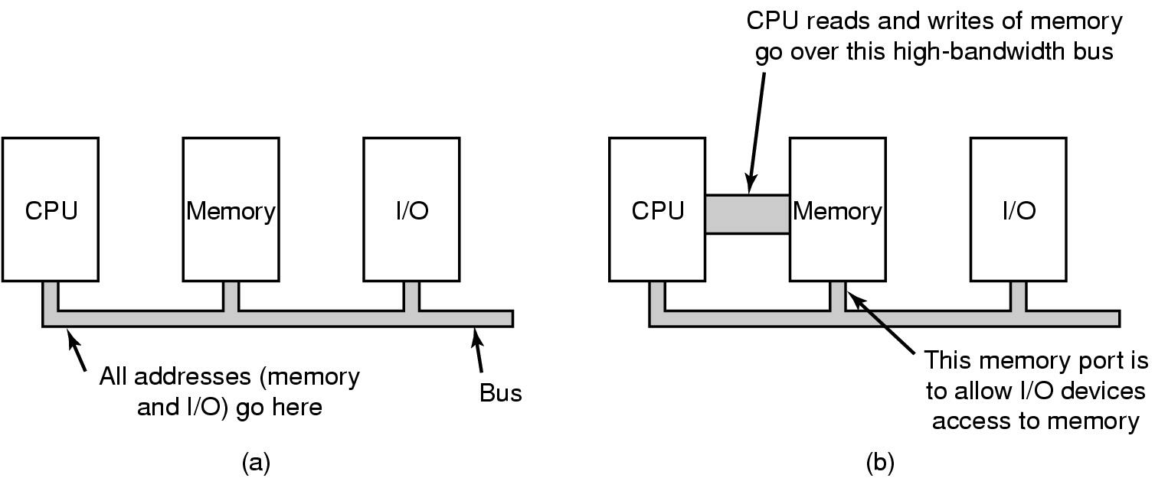
Memory-Mapped I/O (2)
(a) A single-bus architecture
(b) A dual-bus memory architecture

Slide 11

Direct Memory Access (DMA)
Operation of a DMA transfer

Slide 12

Interrupts Revisited
How interrupts happens. Connections between devices and interrupt controller actually use interrupt lines on the bus rather than dedicated wires

Slide 13
Principles of I/O Software
Goals of I/O Software (1)
Device independence
  programs can access any I/O device
  without specifying device in advance
    (floppy, hard drive, or CD-ROM)
Uniform naming
  name of a file or device a string or an integer
  not depending on which machine
Error handling
  handle as close to the hardware as possible

Slide 14
Goals of I/O Software (2)
Synchronous vs. asynchronous transfers
  blocked transfers vs. interrupt-driven
Buffering
  data coming off a device cannot be stored in final destination
Sharable vs. dedicated devices
  disks are sharable
  tape drives would not be

Slide 15
Programmed I/O
Three fundamentally different ways that I/O can be performed:
  Programmed I/O
  Interrupt-driven I/O
  I/O using DMA
The simplest form of I/O is to have CPU do all the work.
  This method is called programmed I/O

Slide 16
Programmed I/O
It is simplest to illustrate programmed I/O by means of an example.
Consider a user process that wants to print the eight-character string “ABCDEFGH” on the printer.
It first assembles the string in a buffer in user space.
The user process then acquires the printer for writing by making a system call to open it.
  If the printer is currently used by another process, this call will fail and return an error code or will block until the printer is available.
  If printer is available, the use process makes a system call telling the OS to print the string on the printer.
The OS then copies the buffer with the string to an array say p in kernel space.
  It then checks to see if printer is currently available. If so the OS copies the first character to the printer’s data register using memory-mapped I/O.
  This action activates the printer

Slide 17
Programmed I/O
The character may not appear yet because some printers buffer a line or a page before printing anything.
As soon as it has copied the first character to the printer, the OS checks to see if the printer is ready to accept another one.
  Generally the printer has a second register which gives its status.
  When printer controller has processed the current character, it indicates its availability by setting some bits in its status register.
At this point, the OS waits for the printer to become ready again.
  When that happens, it prints the next character.
  This loop continues until the entire string is printed.
  Then control returns to the user process.
Programmed I/O is simple but has the disadvantage of tying up the CPU full time until all the I/O is done.

Slide 18
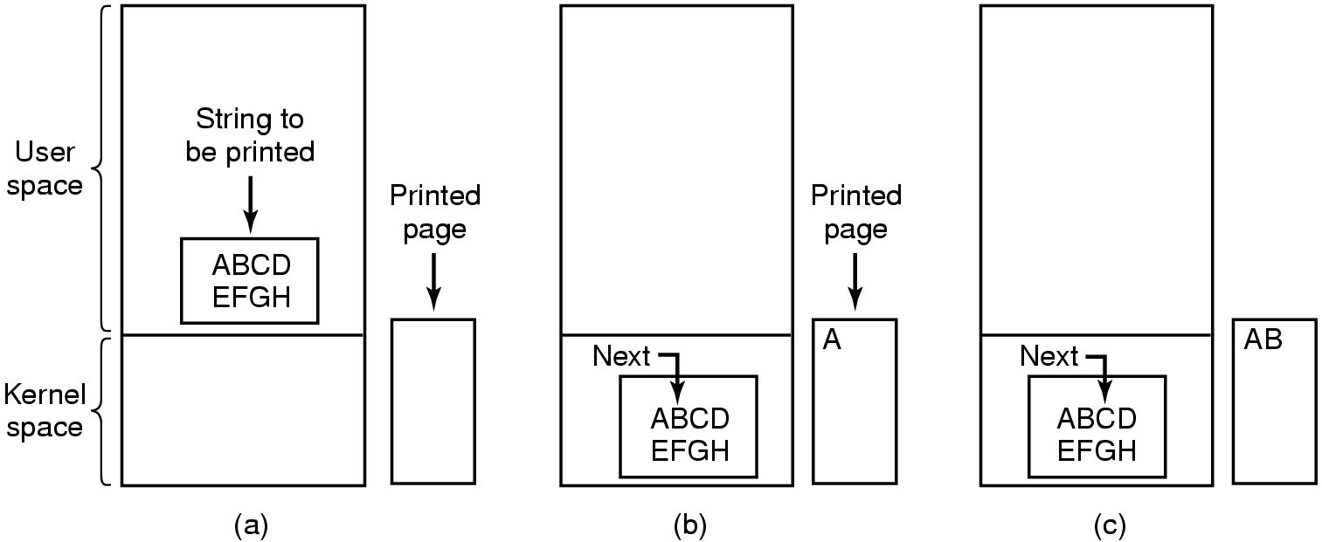
Programmed I/O (1)
Steps in printing a string

Slide 19
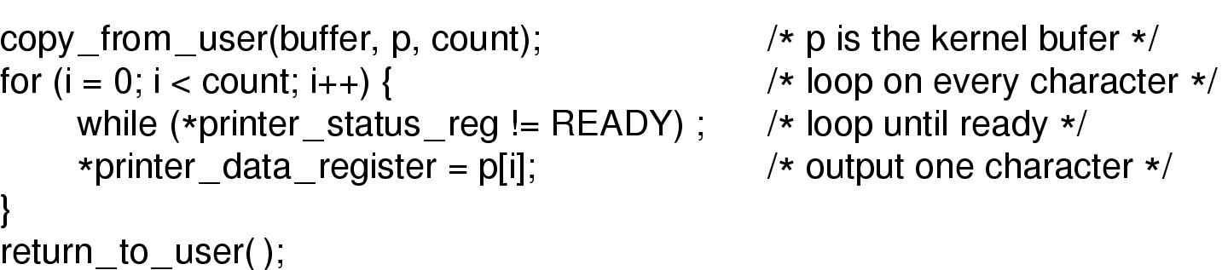
Programmed I/O (2)
Writing a string to the printer using programmed I/O

Slide 20
Interrupt-Driven I/O
Consider the case of printing on a printer that does not buffer characters but print each one as it arrives.
If printer can print, say 100 characters/sec, each character takes 10msec to print.
  This means that after every character is written to the printer’s data register, the CPU will sit in an idle loop for 10msec waiting to be allowed to output the next character.
  This more than enough time to do a context switch and run some other process for 10msec that would otherwise be wasted.
The way to allow CPU to do something else while waiting for the printer to become ready is to use interrupts.
  When the system call to print is made, the buffer is copied to kernel space and the first character is copied to the printer as soon as it is willing to accept a character.
  At that point CPU calls the scheduler and some other process is run.
  The process that asked for the string is blocked until entire string is printed.

Slide 21
Interrupt-Driven I/O
When the printer has printed the character and is prepared to accept the next one, it generates an interrupt.
  This interrupt stops the current process and saves its state.
  Then the printer interrupt service procedure is run.
  If there are no more characters to print, the interrupt handler takes some action to unblock the user.
  Else, it outputs the next character, acknowledges the interrupt and returns to the process that was running just before the interrupt, which continues from where it left off.

Slide 22
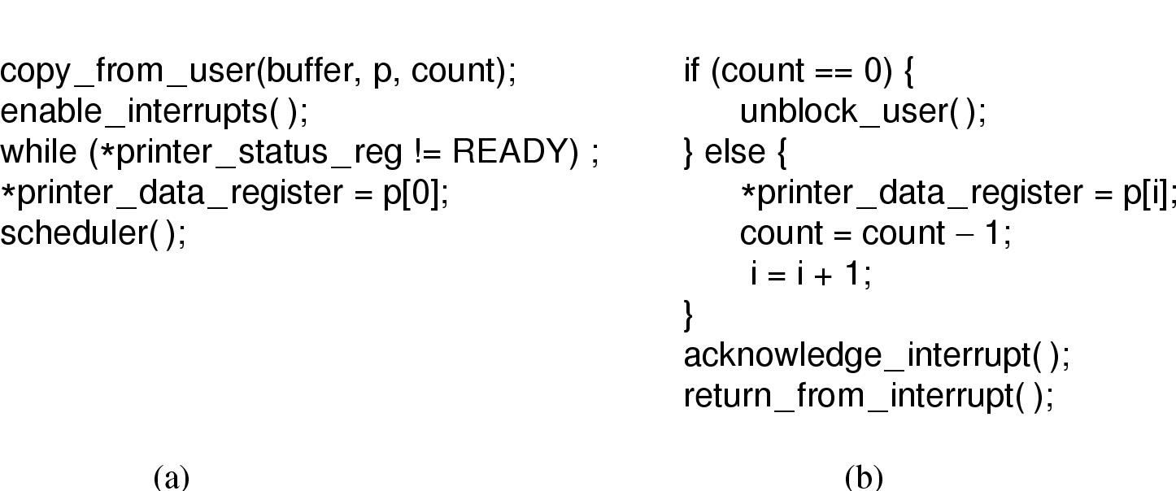
Interrupt-Driven I/O
Writing a string to the printer using interrupt-driven I/O
  Code executed when print system call is made
  Interrupt service procedure

Slide 23
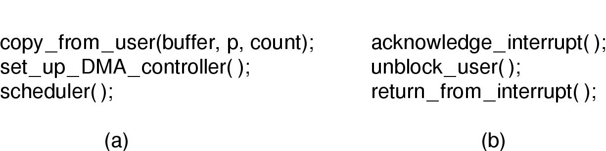
I/O Using DMA
Printing a string using DMA
  code executed when the print system call is made
  interrupt service procedure

Slide 24
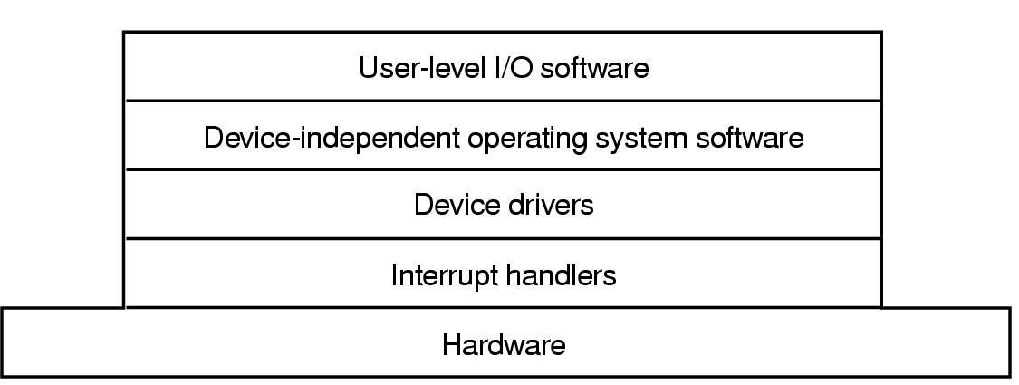
I/O Software Layers
Layers of the I/O Software System

Slide 25
Interrupt Handlers (1)
Interrupt handlers are best hidden
  have driver starting an I/O operation block until interrupt notifies of completion
Interrupt procedure does its task
  then unblocks driver that started it
  In some it will just complete up on a semaphore.
  In some it will send a message to the blocked driver.
Steps must be performed in software after interrupt completed
  Save regs not already saved by interrupt hardware
  Set up context for interrupt service procedure

Slide 26
Interrupt Handlers (2)
  Set up stack for interrupt service procedure
  Ack interrupt controller, reenable interrupts
  Copy registers from where saved
  Run service procedure
  Set up MMU context for process to run next
  Load new process' registers
  Start running the new process

Slide 27
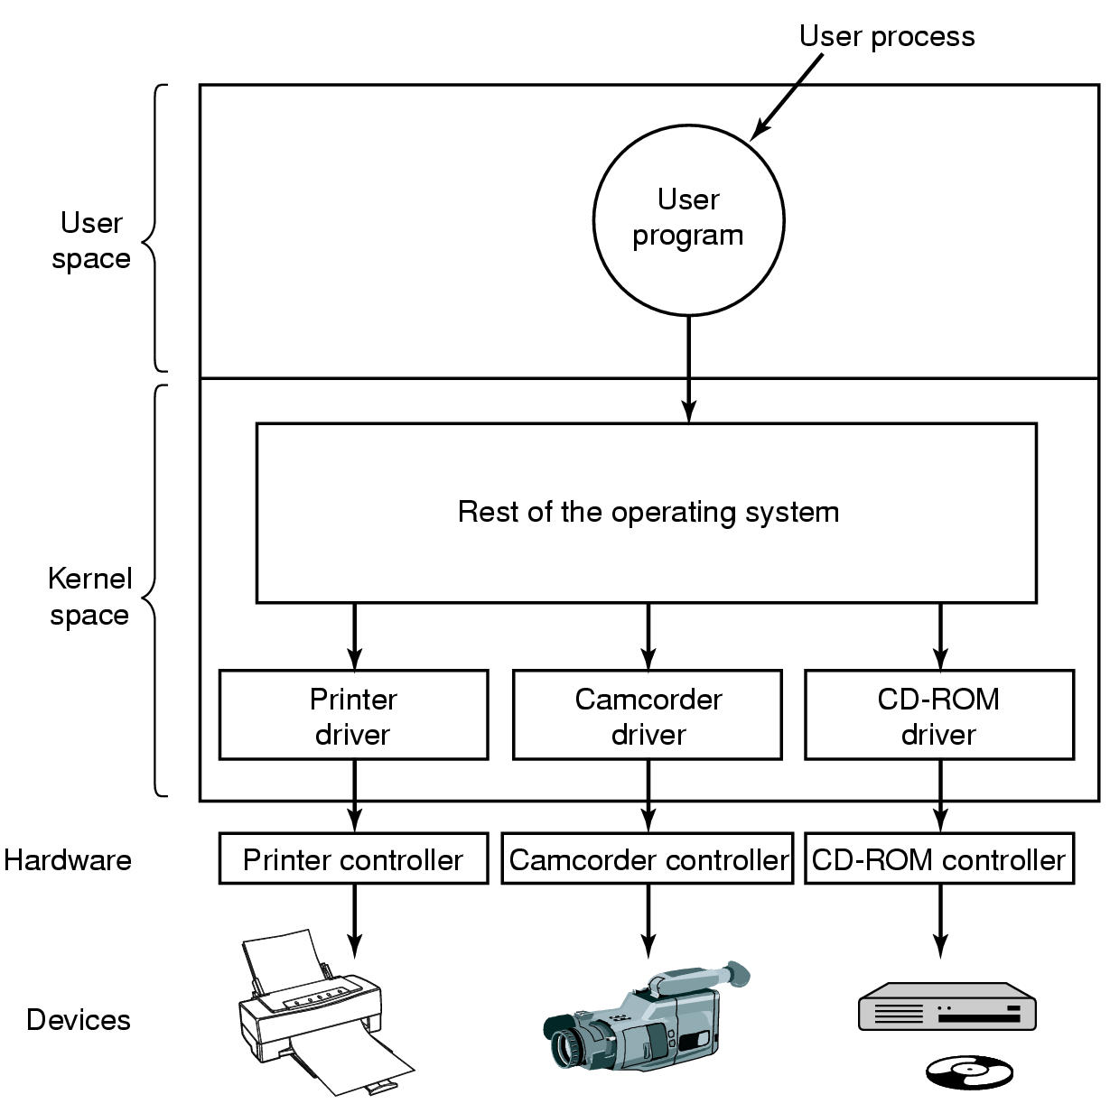
Device Drivers
Logical position of device drivers is shown here
Communications between drivers and device controllers goes over the bus

Slide 28
Device Drivers
Each I/O device attached to a computer needs some device-specific code for controlling it.
This code is called the device driver.
  Is generally written by the device’s manufacturer and delivered along with the device.
Since each OS needs its own drivers, device manufacturers commonly supply drivers for several popular Oses.
Each device driver handles one device types or at most one class of closely related devices.
Example SCSI disk driver may handle SCSI disks as well as SCSI CD-ROM
A mouse may require a different device driver so also a joystick.

Slide 29
Device Drivers
In order to access the device’s hardware (ie controller’s registers), the device driver normally has to be part of the OS kernel (at least with current architectures)
Device drivers are normally positioned below the rest of the OS.
OS classify drivers into
  Block devices drivers: such as disks
  Character devices drivers: such as keyboards, printers
Most Oses define a standard interface that all block drivers must support and a second standard interface that all character devices must support.
These interfaces consist of a number of procedures that the rest of the OS can call to get the driver to work for it.
Typical procedures are read a block or write a character string.

Slide 30
Functions of Device drivers
To accept abstract read and write requests from device-independent s/w above it and see that they are carried out.
  Few other functions are there that they perform
  Example, the driver must initialize the device if needed.
  It may also need to manage its power requirements and log events.
Many device drivers have a general structure.
  A typical driver starts out by checking the input parameters to see if they are valid.
  If not error are returned.
  If valid, a translation from abstract to concrete terms may be needed.
  This may mean converting a linear block number into the head, track, sector and cylinder number for the disk’s geometry.

Slide 31
Functions of Device drivers
Next the driver may check if the device is currently in use.
  If it is, the request will be queued for later processing.
  If idle, the h/w status will be examined to see if the request can be handled now.
Controlling the device means issuing a sequence of commands to it
  The driver is the place where the command sequence is determined, depending on what has to be done.
  After it knows which commands it its going to issue, it starts writing them into the controller’s device registers.
  After writing each command to the controller, it is necessary to check to see if the controller accepted the command and is prepared to accept the next one.
  This sequence continues until all commands have been issued.

Slide 32
Device-Independent I/O Software (1)
Uniform interfacing for device drivers
Buffering
Error reporting
Allocating and releasing dedicate devices
Providing a deice-independent block size
Functions of the device-independent I/O software

Slide 33
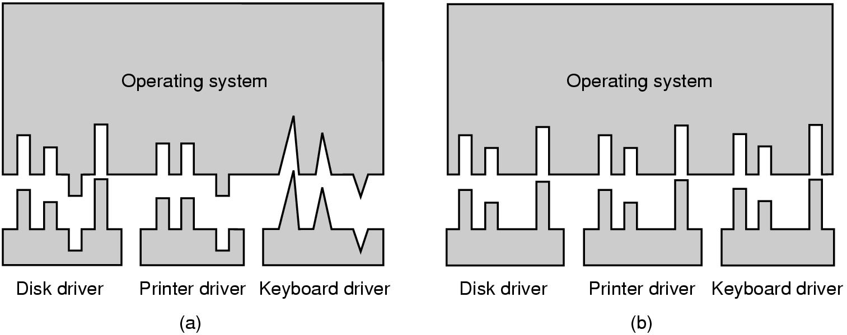
Device-Independent I/O Software (2)
(a) Without a standard driver interface
(b) With a standard driver interface

Slide 34
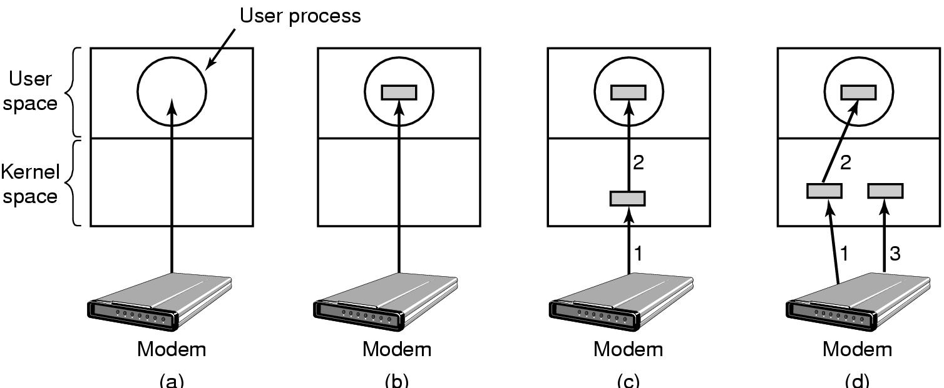
Device-Independent I/O Software (3)
(a) Unbuffered input
(b) Buffering in user space
(c) Buffering in the kernel followed by copying to user space
(d) Double buffering in the kernel

Slide 35
Buffering
Consider a process that wants to read data from a modem.
One possible strategy for dealing with incoming characters is to have the user process do a read system call and block waiting for one character.
  Each arriving character causes an interrupt.
  The interrupt service procedure hands the character to the user process and unblocks it.
  After putting the character somewhere, the process reads another character and blocks again.
  This design is inefficient to allow a process to run many times for short runs.
Another strategy is the user process provides an n-character buffer in user space and does a read of n characters.
  The interrupt service procedure puts incoming characters in this buffer until it fills up.
  Then it wakes up the user process.
  This has a drawback: What happens if the buffer is paged out when a character arrives?
  The buffer could be locked in memory, but if many processes start locking pages in memory, the pool of available pages will shrink and performance will degrade.

Slide 36
Buffering
Another approach is to create a buffer inside the kernel and have the interrupt handler put the characters there.
  When this buffer is full, the page with the user buffer is brought in, if needed, and the buffer copied there in one operation.
  This scheme suffers from a problem: What happens to characters that arrive while the page with the user buffer is being brought in from the disk?
  Since the buffer is full, there is no place to put them.
  A way out is to have a second kernel buffer.
  After the first buffer fills up, but before it has been emptied, the second one is used.
  When second buffer fills up, it is available to be copied to the user.
  While second buffer is being copied to user space, the first one can be used for new characters.
  In this way, two buffers take turns: while one is being copied to user space, the other is accumulating new input.
This scheme is called double buffering.

Slide 37
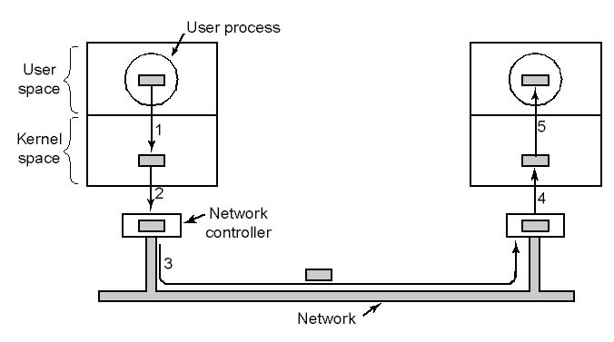
Device-Independent I/O Software (4)
Networking may involve many copies

Slide 38
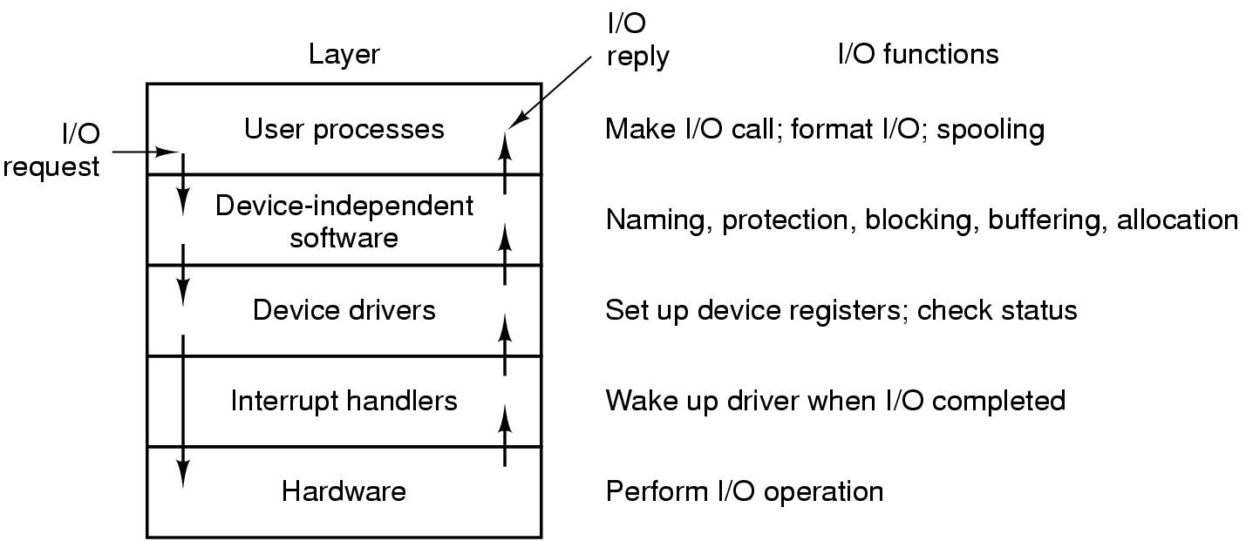
User-Space I/O Software
Layers of the I/O system and the main functions of each layer

Slide 39
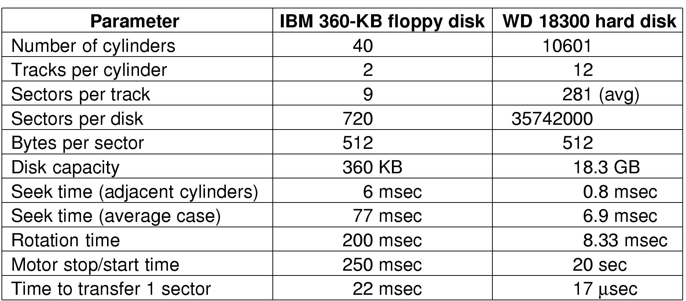
Disks
Disk Hardware (1)
Disk parameters for the original IBM PC floppy disk and a Western Digital WD 18300 hard disk

Slide 40
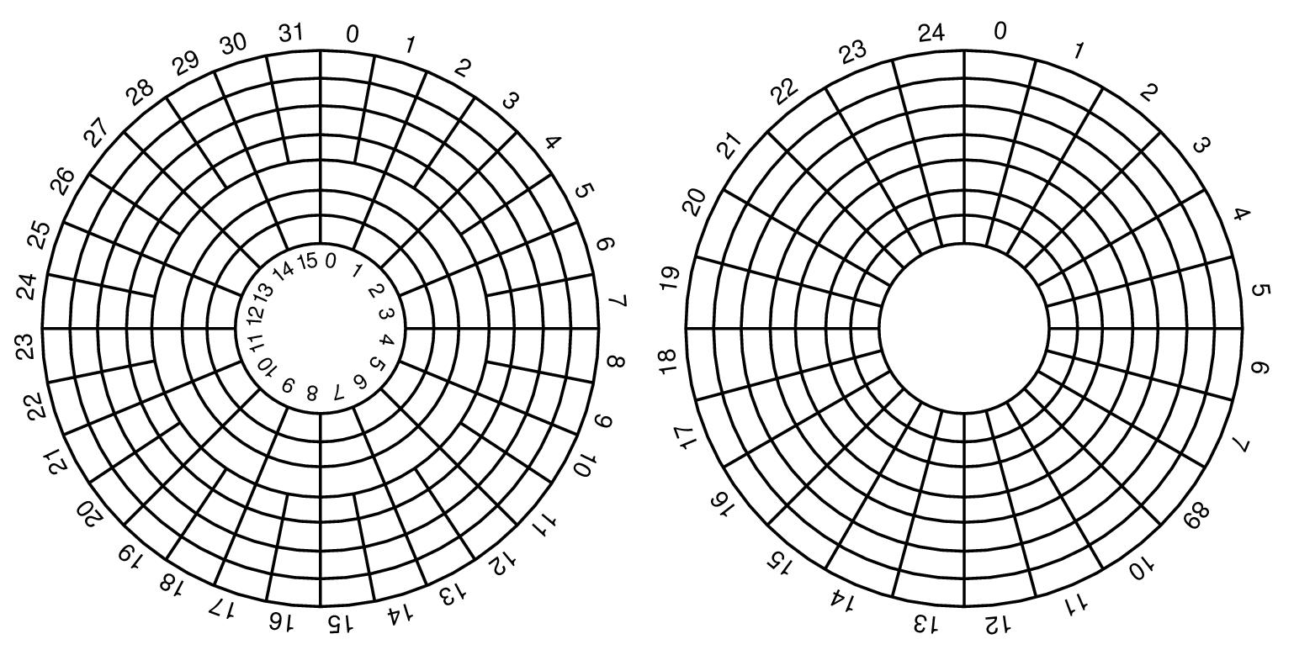
Disk Hardware (2)
Physical geometry of a disk with two zones
A possible virtual geometry for this disk

Slide 41
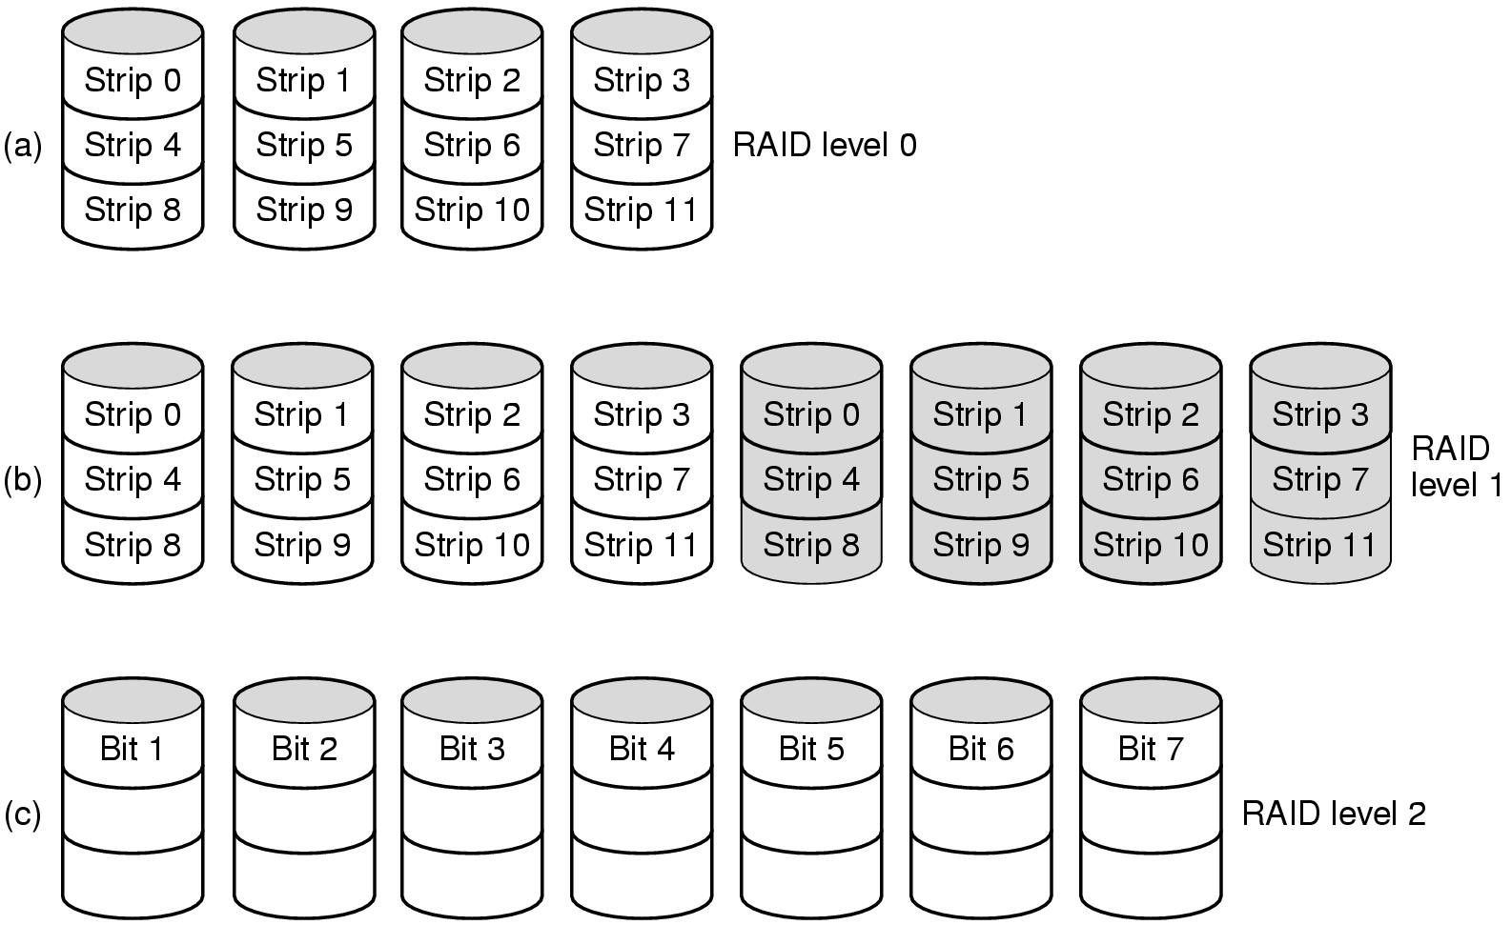
Disk Hardware (3)
Raid levels 0 through 2
Backup and parity drives are shaded

Slide 42
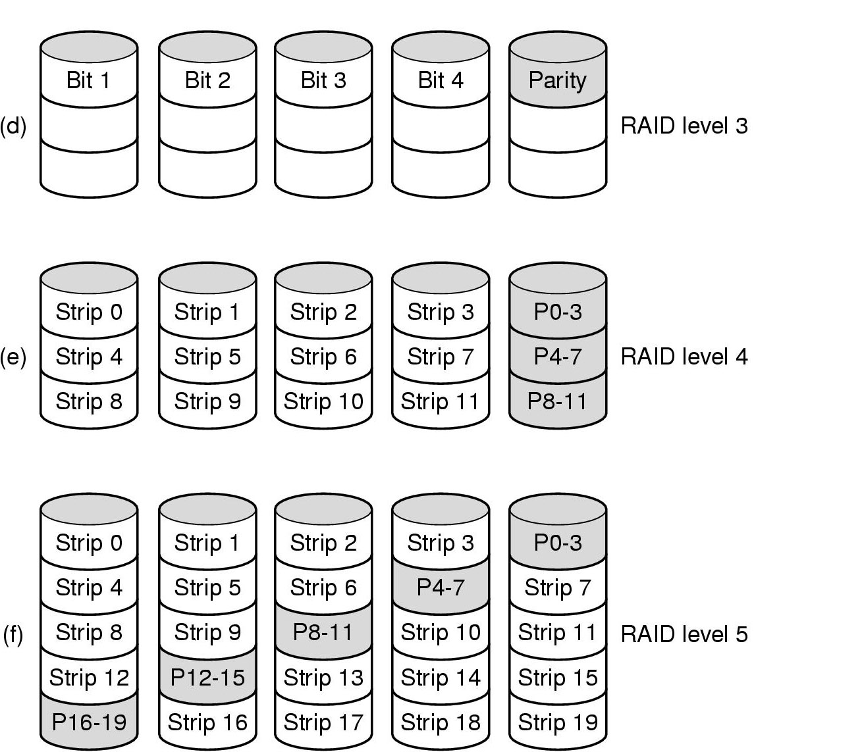
Disk Hardware (4)
Raid levels 3 through 5
Backup and parity drives are shaded

Slide 43
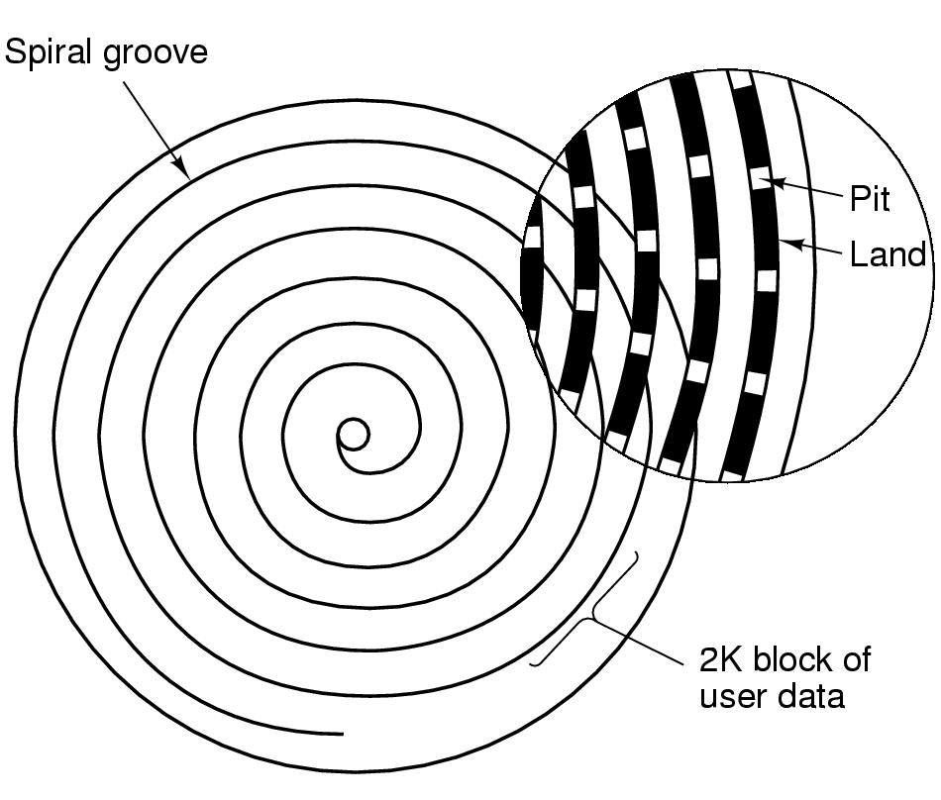
Disk Hardware (5)
Recording structure of a CD or CD-ROM

Slide 44
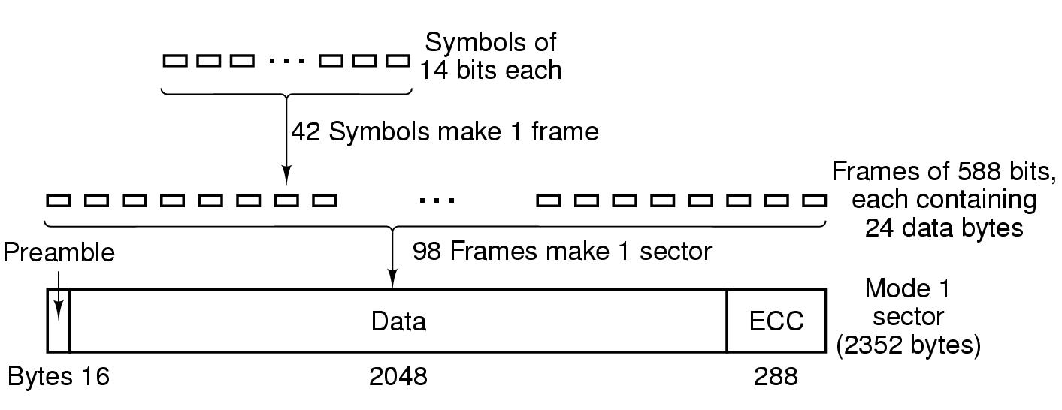
Disk Hardware (6)
Logical data layout on a CD-ROM

Slide 45
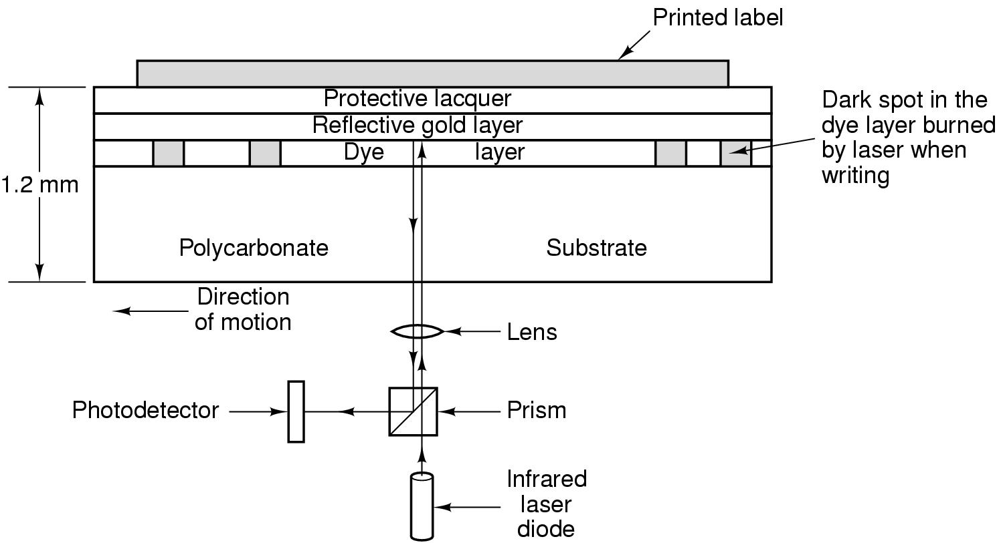
Disk Hardware (7)
Cross section of a CD-R disk and laser
  not to scale
Silver CD-ROM has similar structure
  without dye layer
  with pitted aluminum layer instead of gold

Slide 46
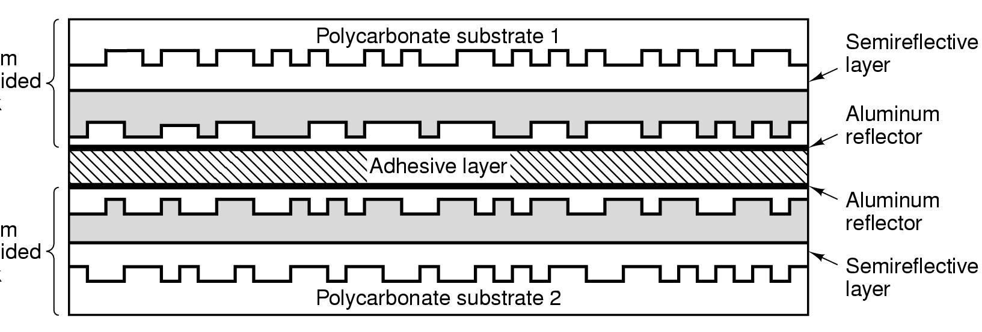
Disk Hardware (8)
A double sided, dual layer DVD disk

Slide 47
Disk Formatting (1)
A disk sector

Slide 48
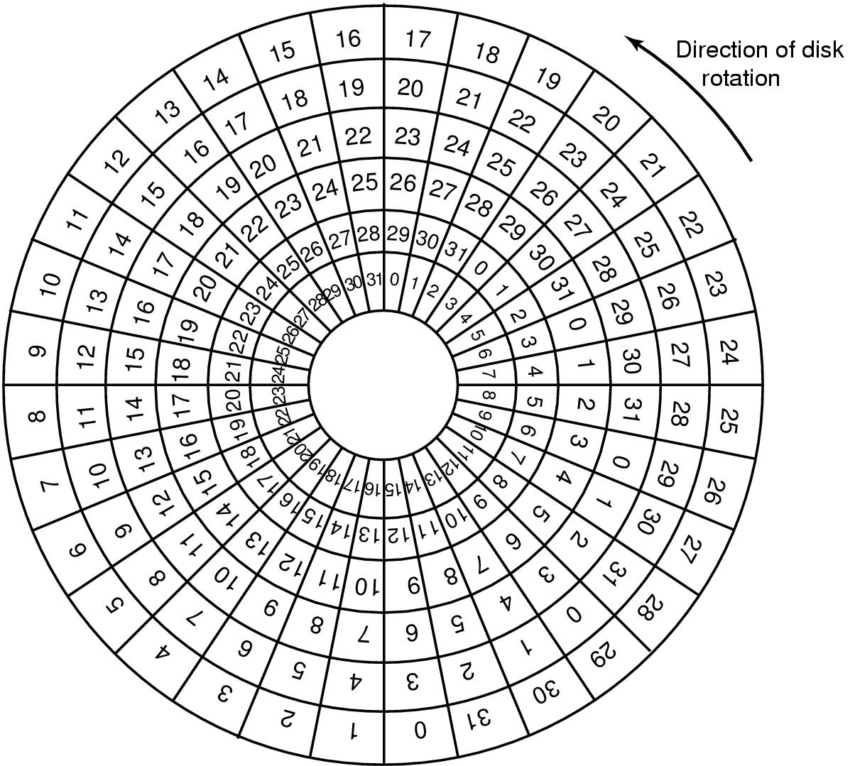
Disk Formatting (2)
An illustration of cylinder skew

Slide 49
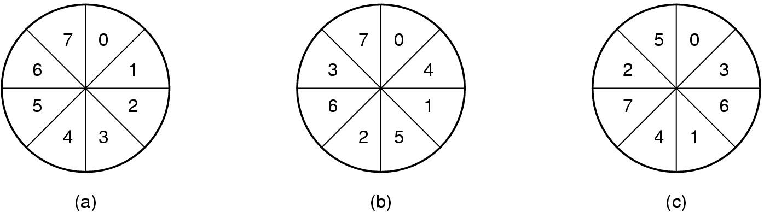
Disk Formatting (3)
No interleaving
Single interleaving
Double interleaving

Slide 50
Disk Arm Scheduling Algorithms (1)
Time required to read or write a disk block determined by 3 factors
  Seek time
  Rotational delay
  Actual transfer time
Seek time dominates
Error checking is done by controllers

Slide 51
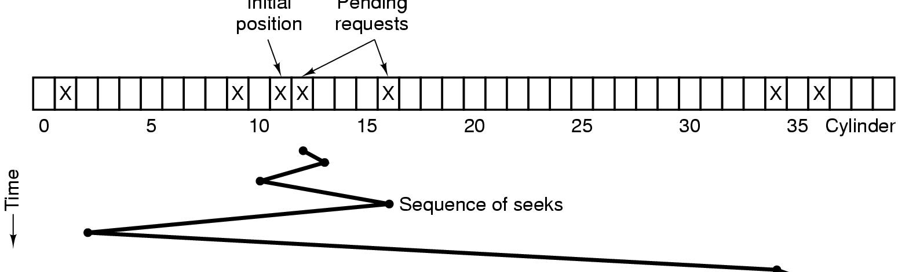
Disk Arm Scheduling Algorithms (2)
Initial
position
Pending
requests
Shortest Seek First (SSF) disk scheduling algorithm

Slide 52
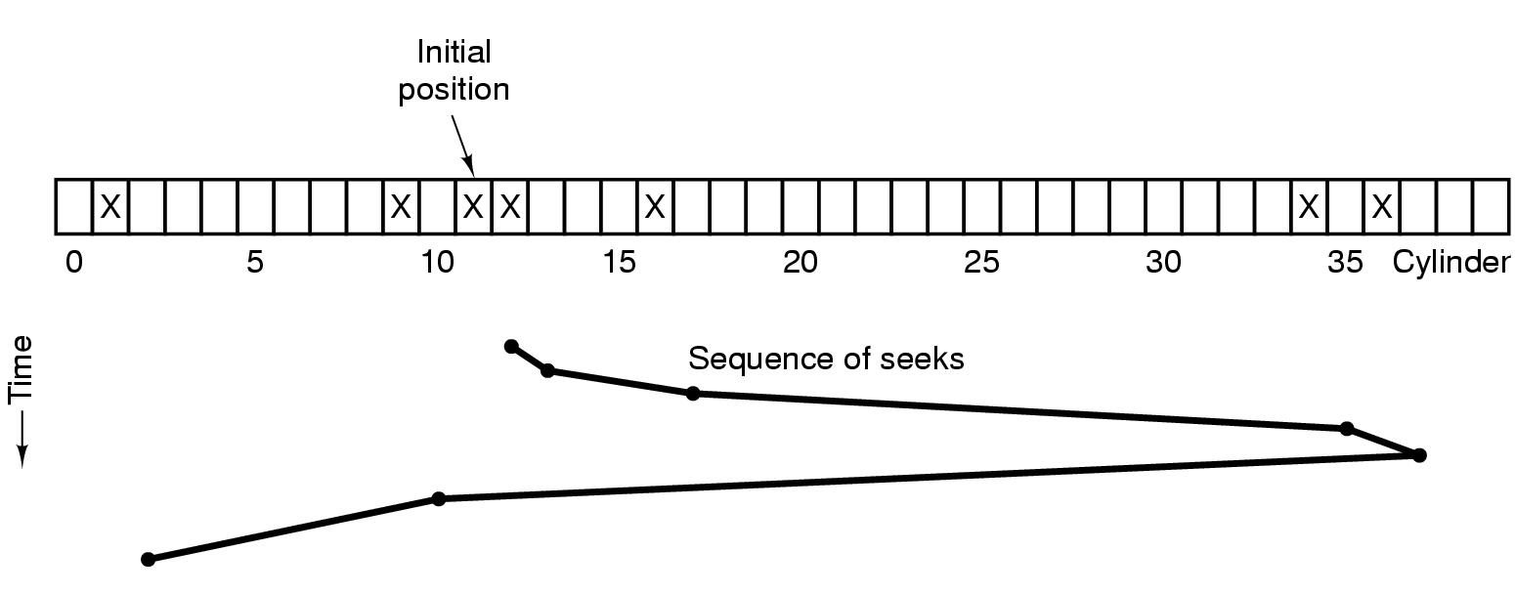
Disk Arm Scheduling Algorithms (3)
The elevator algorithm for scheduling disk requests

Slide 53
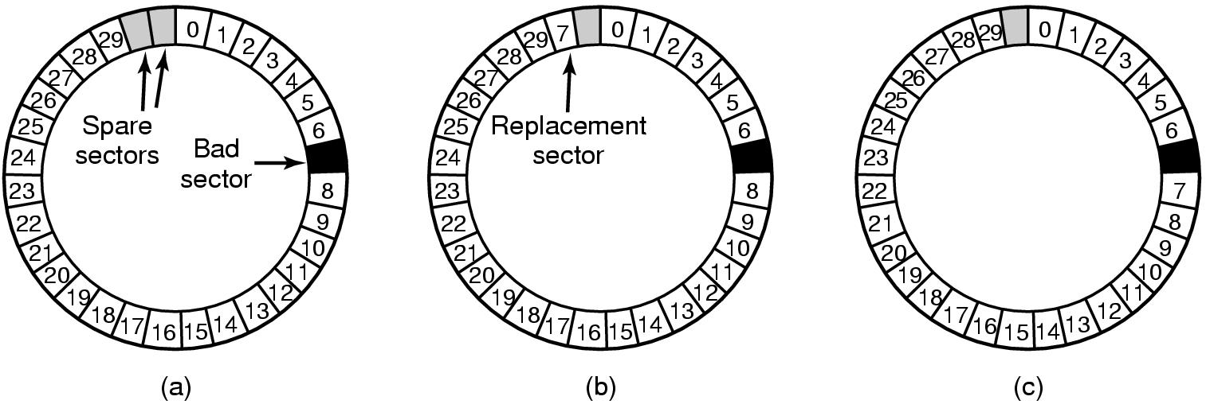
Error Handling
A disk track with a bad sector
Substituting a spare for the bad sector
Shifting all the sectors to bypass the bad one

Slide 54
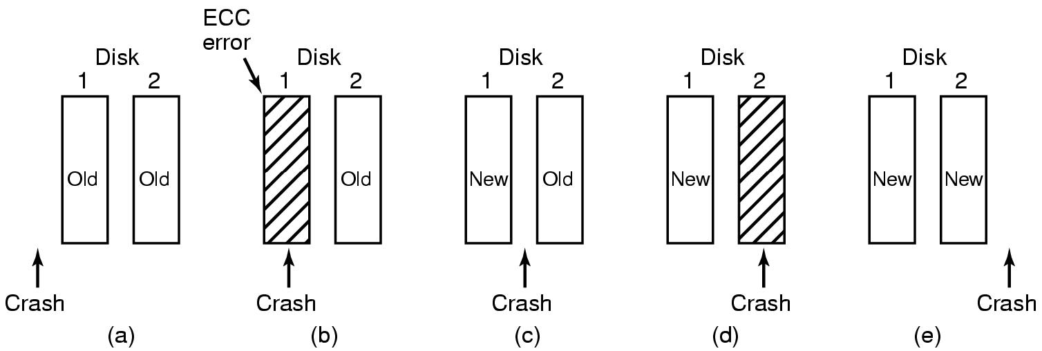
Stable Storage
Analysis of the influence of crashes on stable writes

Slide 55
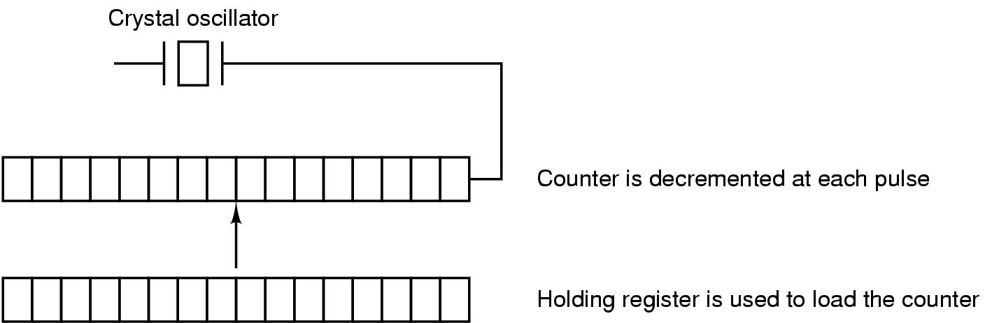
Clocks
Clock Hardware
A programmable clock

Slide 56
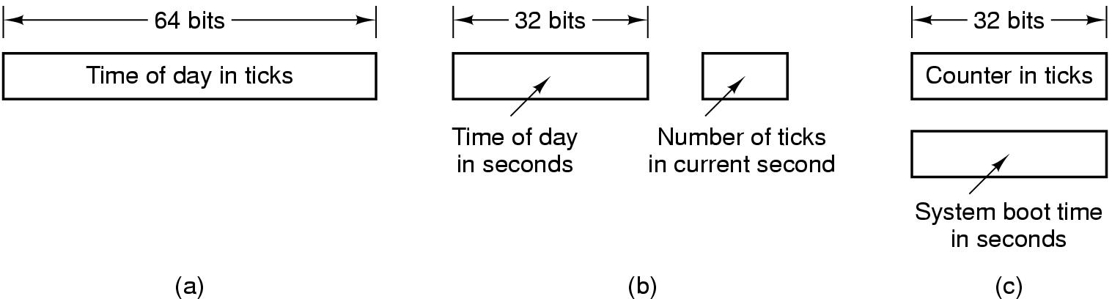
Clock Software (1)
Three ways to maintain the time of day

Slide 57
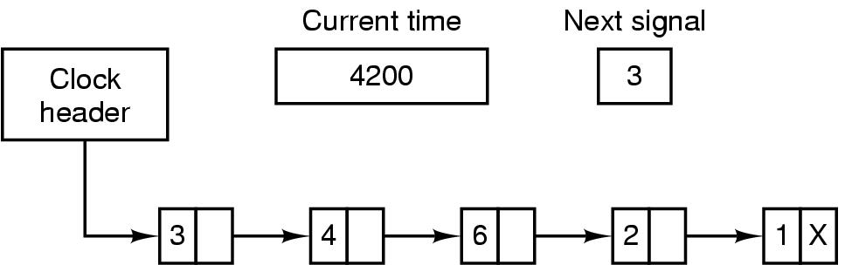
Clock Software (2)
Simulating multiple timers with a single clock

Slide 58
Soft Timers
A second clock available for timer interrupts
  specified by applications
  no problems if interrupt frequency is low
Soft timers avoid interrupts
  kernel checks for soft timer expiration before it exits to user mode
  how well this works depends on rate of kernel entries

